Slide 1
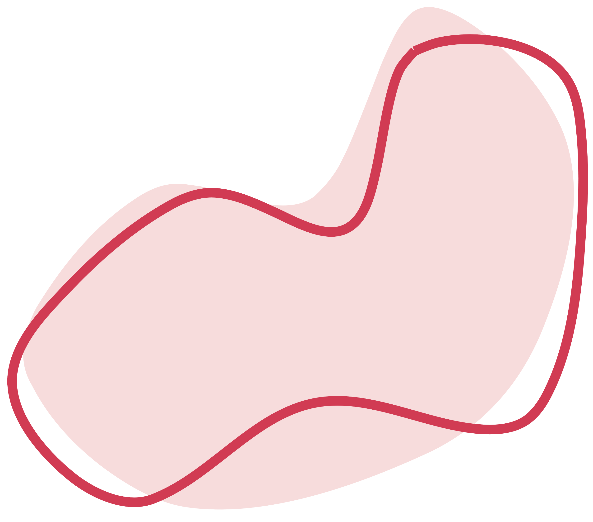



AI in Medical Service & Health Care
Presented by Thi Ngoc Phung Cao and Soyeong Yi

Slide 2

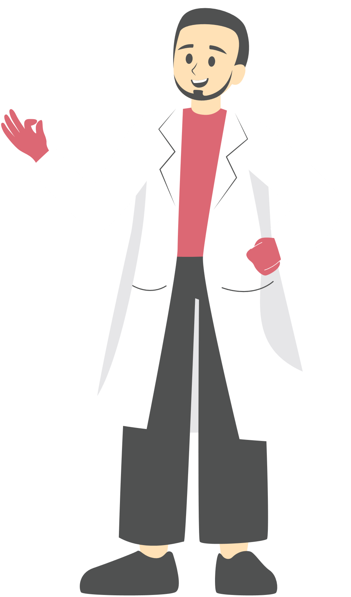
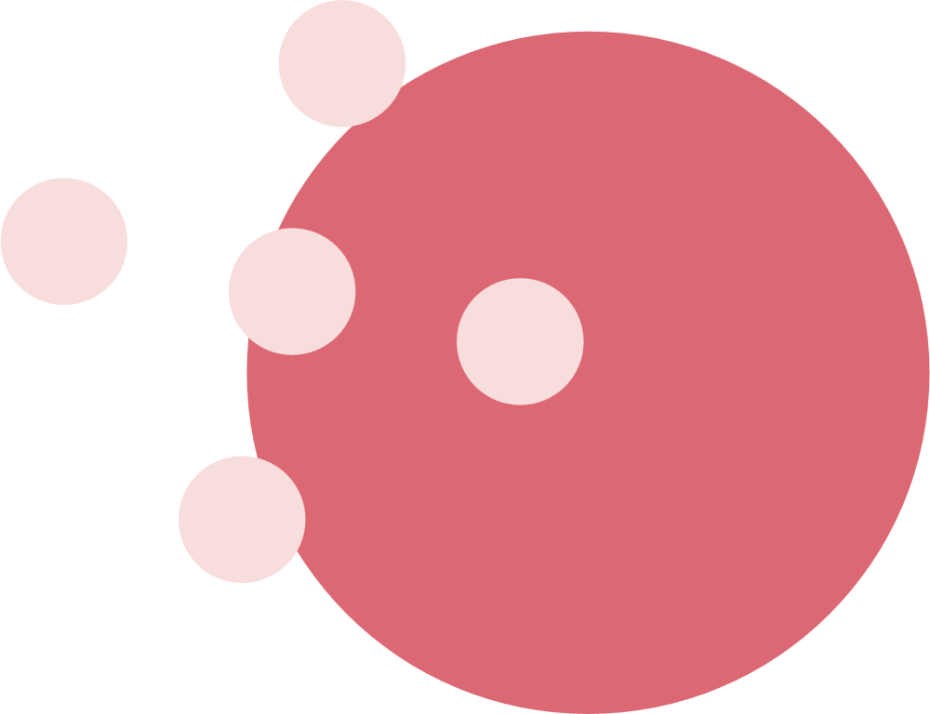

1. Introduction
Development in AI applications in skin cancer screening and diagnosis
Deep Learning CNNs, which have achieved dermatologist-level accuracy
Integrate clinical data, analyze multiple lesions simultaneously, and Learn from whole-slide images

Slide 3

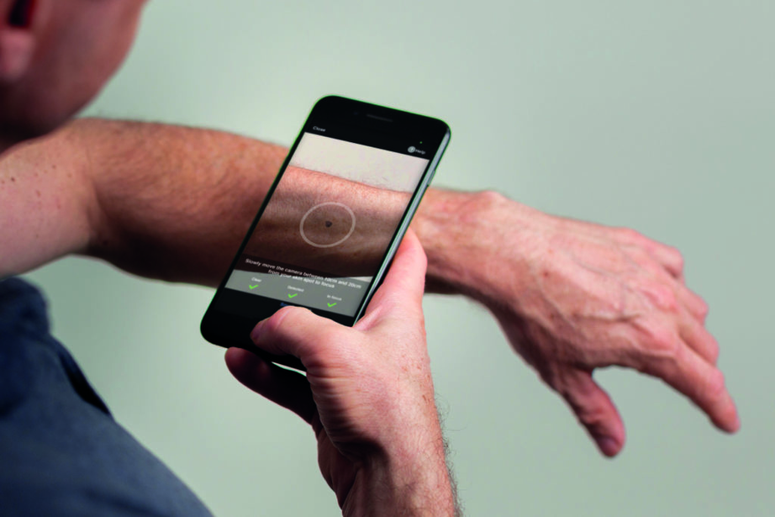
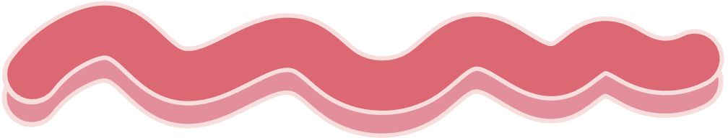
2. Overview of SkinVisions
Artificial intelligence-based application that can detect skin cancers
Provide users with personalized advice
Devide skin lesions into three risk categories
Sensitivity ranging from 41.3% to 83.3% and specificity from 60.0% to 82.9%

Slide 4

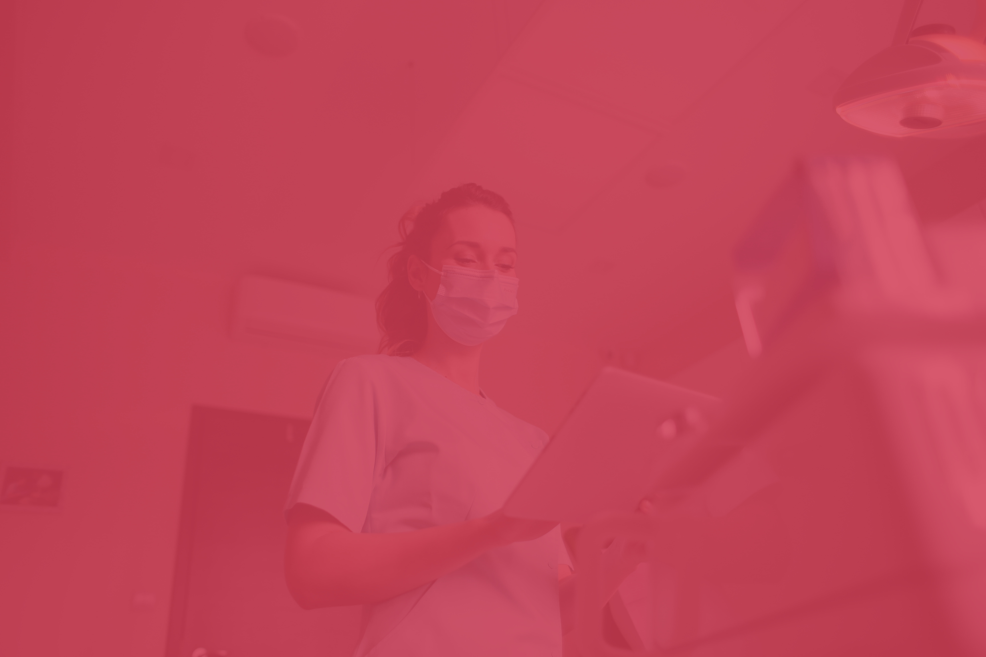
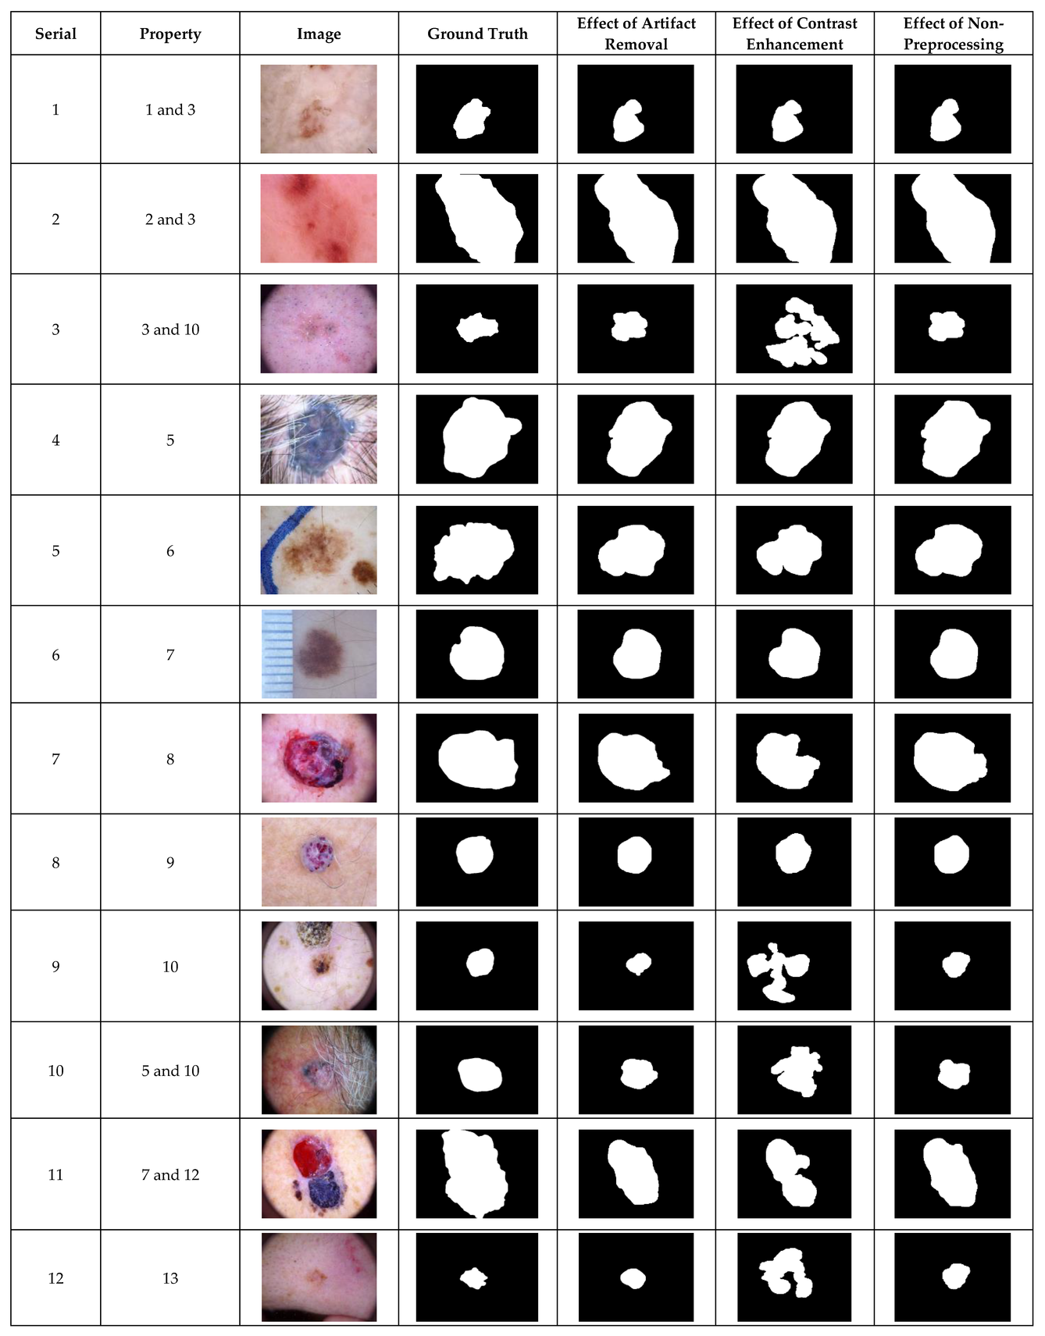
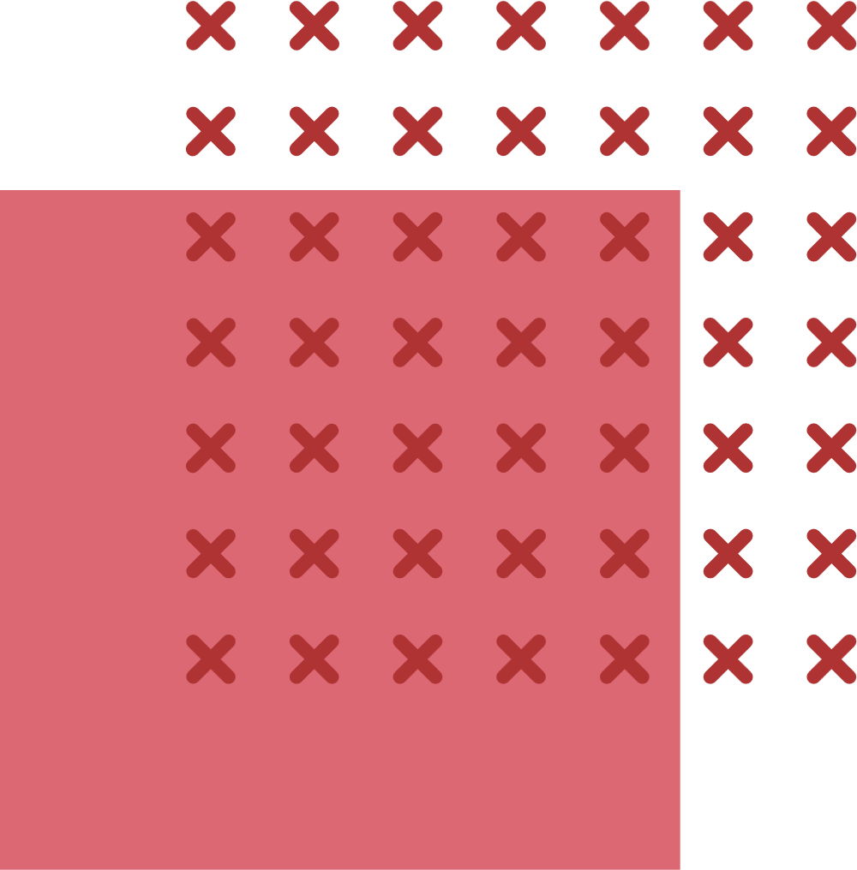
3. Data & Preprocessing
Images of skin lesion collected form dermatological sources
Images are resized to a fixed resolution and normalized to reduce lighting and color variations
Simple filters to remove noise such as hair and shadow
Images are segmented by U-Net model and converted to RGB
Augmentation methods are applied

Slide 5


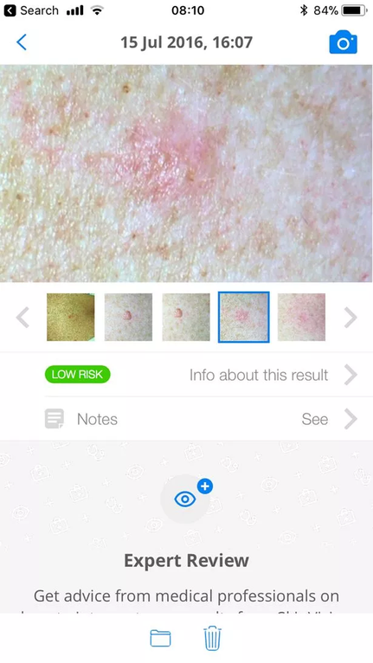
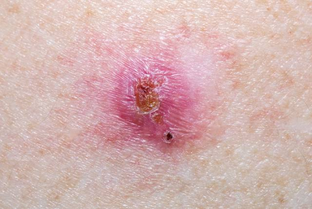
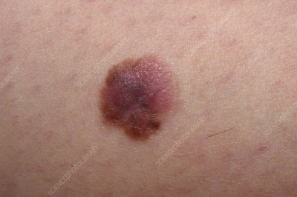
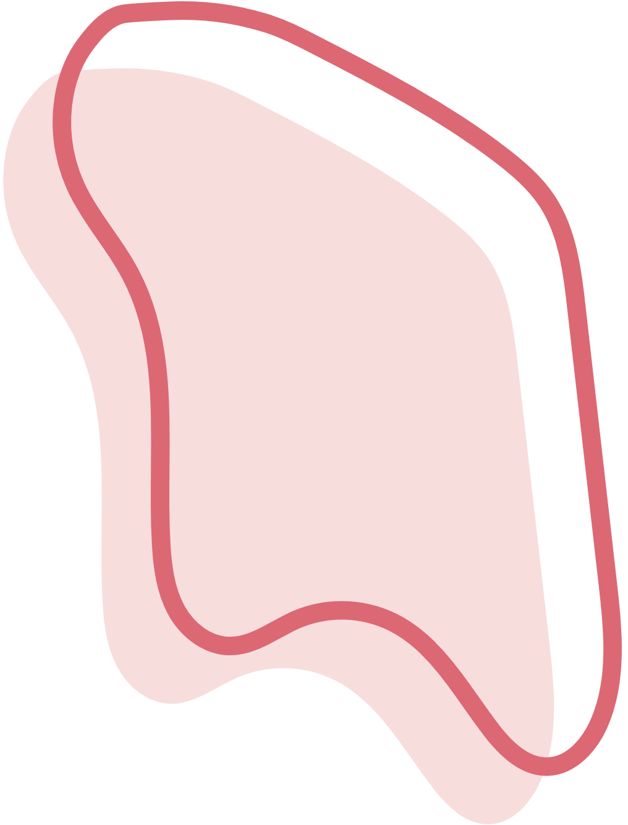

4. Core Algorithms
Convolutional Neural Networks (CNNs)
analyze smartphone images and classify them into 3 groups
Low
Medium
High
Sensitivity 41–83 %
Specificity 60–83 %
AUROC 0.62–0.72

Slide 6
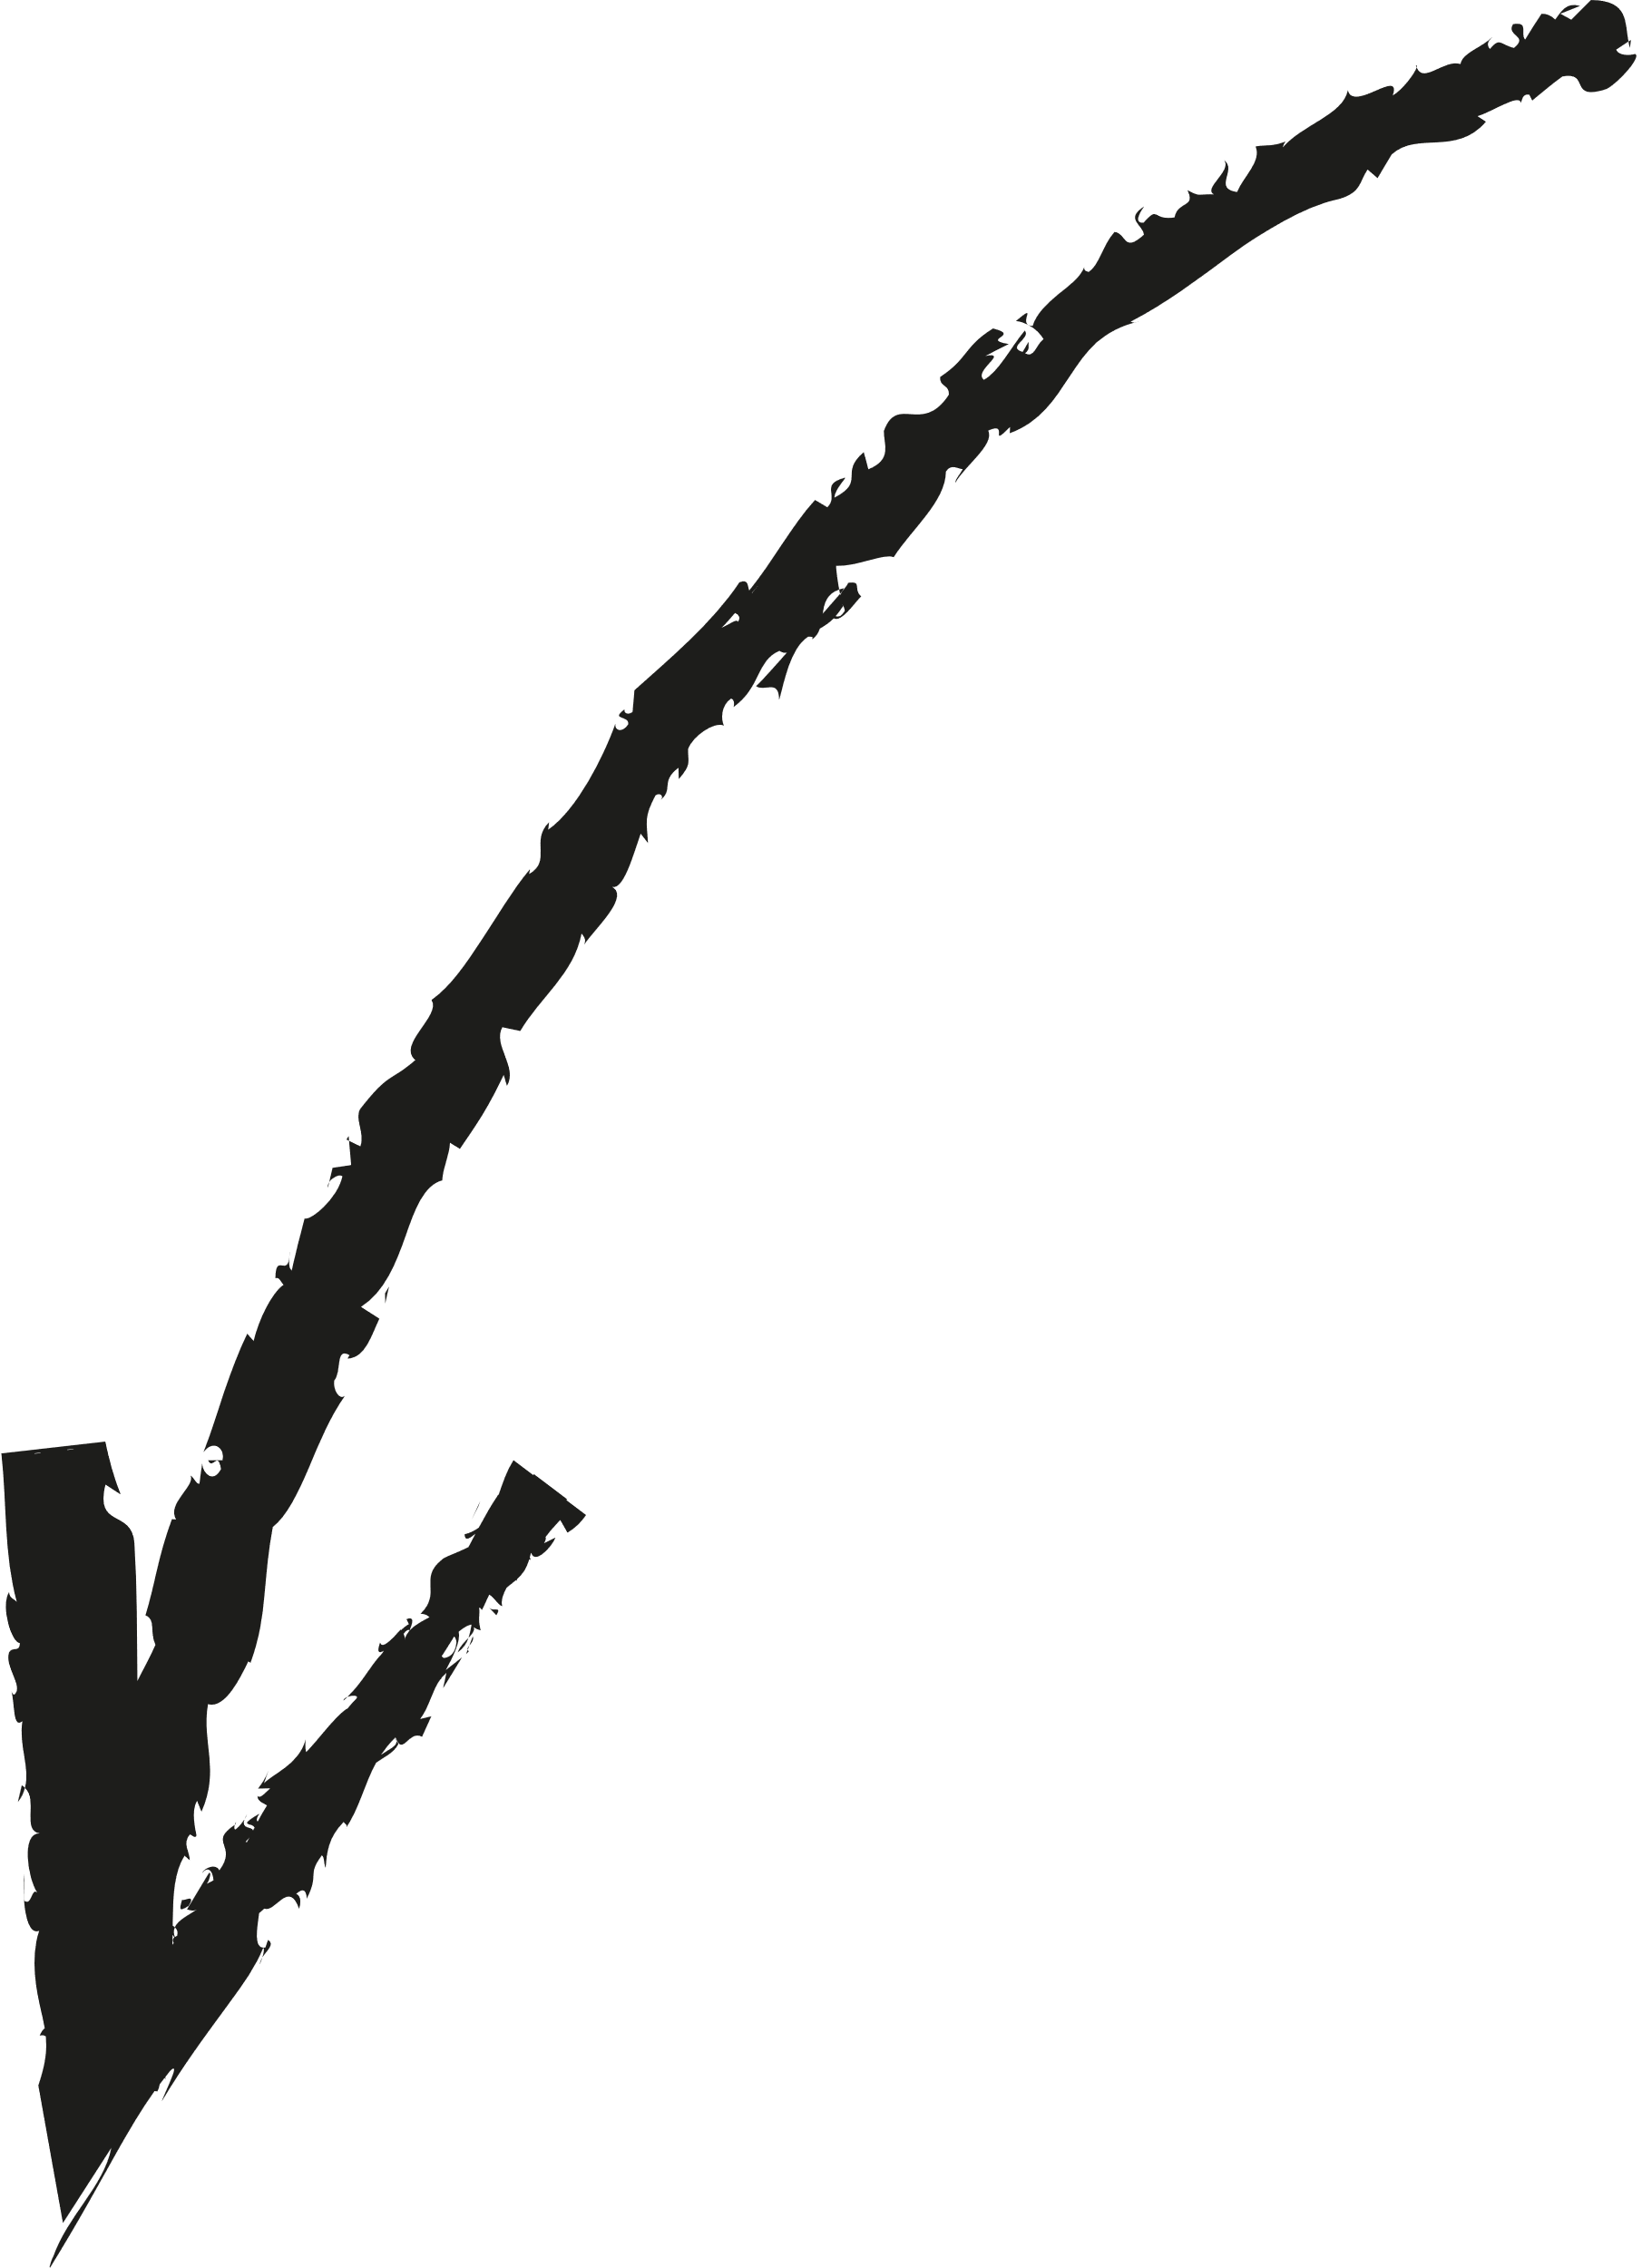
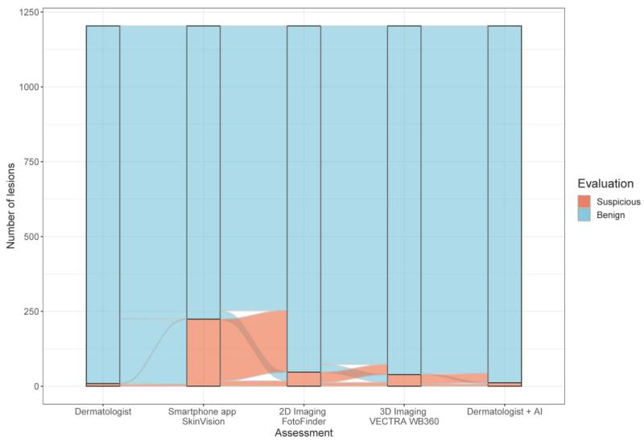

5. Evaluation Metrics
1204 lesions tests
9 (0.7 %) suspicious cases
980 (81 %) as benign
224 (19 %) as suspicious
The app produced a 27-fold higher rate of ‘melanoma-suspect’ results compared to human experts

Slide 7

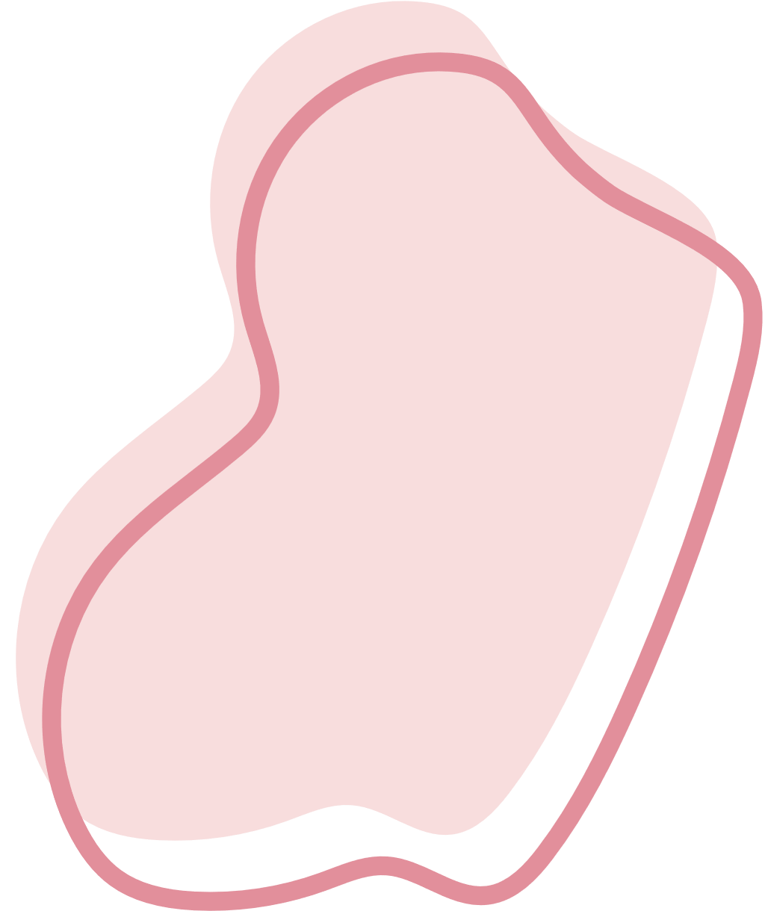



How to use Skinvision?
How to use SkinVision? - YouTube

Slide 8

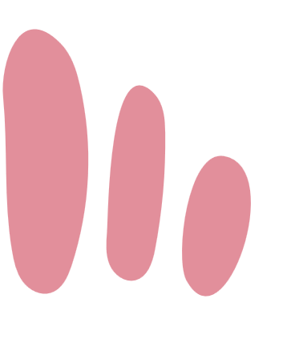

7. Conclusion
Positive
Awareness of skin cancer screening and self-examination
Instant AI-based risk assessment for early detection
Useful in areas with limited dermatology access
Reported sensitivity up to 87 % and specificity ≈ 80 %

Slide 9
7. Conclusion
Negative
Sensitivity 41–83 %, specificity 60–83 %, AUROC 0.62–0.72
-> lower than dermatologists (AUROC > 0.90)
Over-detect suspicious lesions
False positives and unnecessary excisions
Conflict of interest and bias

Slide 10
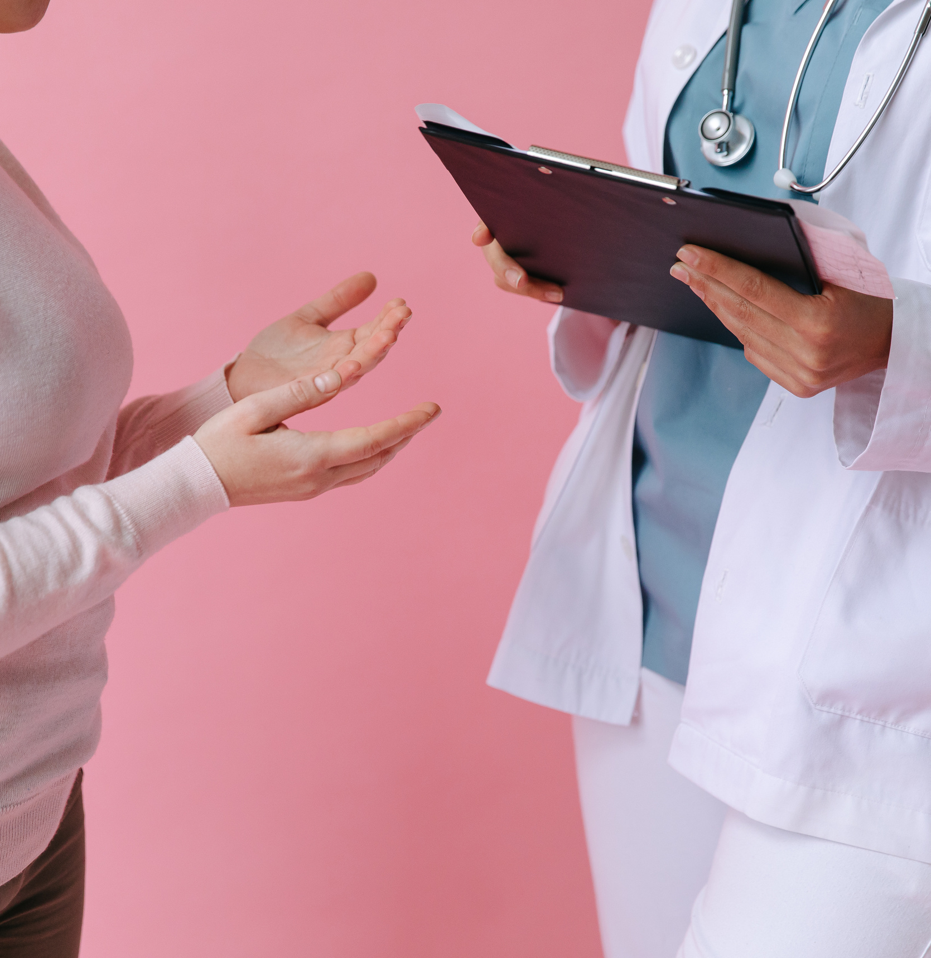

Thank you!

